Slide 1
Chapter 5
Control Structures II (Repetition)

Slide 2
Objectives (1 of 2)
In this chapter, you will:
  Learn about repetition (looping) control structures
  Learn how to use a while loop in a program
  Explore how to construct and use counter-controlled, sentinel-controlled, flag-controlled, and EOF-controlled repetition structures
  Learn how to use a for loop in a program
  Learn how to use a do…while loop in a program

Slide 3
Objectives (2 of 2)
  Examine break and continue statements
  Discover how to form and use nested control structures
  Learn how to avoid bugs by avoiding patches
  Learn how to debug loops

Slide 4
Why Is Repetition Needed?
Repetition allows efficient use of variables
It is possible to input, add, and average multiple numbers using a limited number of variables
Consider the code to determine the average number of calories burned each day doing regular exercise
  Method 1: Declare a variable for each day and enter the number of calories burned, add the values and store in a variable for the week’s total, and divide the total by 7 to find the average
  Method 2: Create a loop that reads a number into a variable and adds it to a variable that contains the sum of the numbers (only two variables needed)

Slide 5
Requirements of loop control variable (LVC)
LVC used to control the loop body initialize and execution.
Three requirements of LVC
  Initialization
  - process of giving a variable an initial value.
  - Important for counting number or sum of variable
  Evaluation
    - How many loops will be done.
    - The process will be repeated as long as the condition is true.
  3. Updating
  - Update the initial value followed by an increase or decrease in the value until the ending value is reached.

Slide 6

while Looping (Repetition) Structure (1 of 3)
A while loop is one of three repetition, or looping structures in C++
Syntax of the while statement
The statement can be simple or compound
The expression acts as a decision maker and is usually a logical expression
The statement is called the body of the loop
The parentheses are part of the syntax

Slide 7
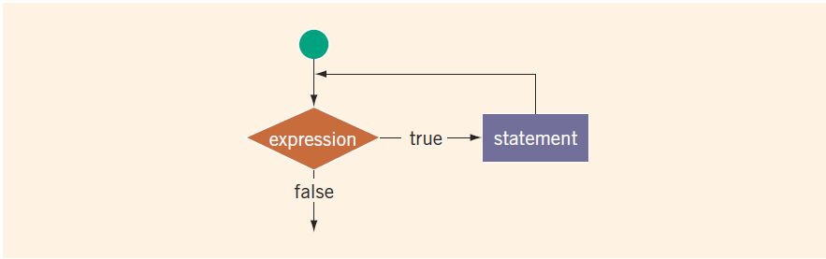
while Looping (Repetition) Structure (2 of 3)
FIGURE 5-1 while loop
The expression provides an entry condition to the loop
The statement (body of the loop) continues to execute until the expression is no longer true
An infinite loop continues to execute endlessly

Slide 8
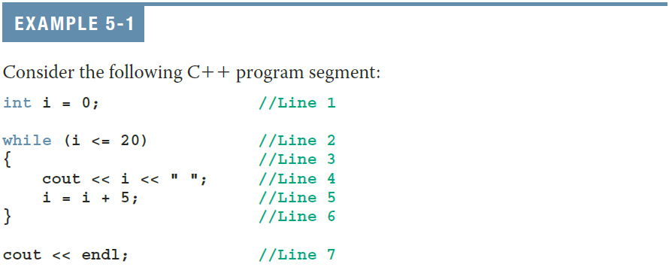
while Looping (Repetition) Structure (3 of 3)
The preceding while loop produces the following output:
0 5 10 15 20
The variable i in Example 5-1 is called the loop control variable (LCV)

Slide 9
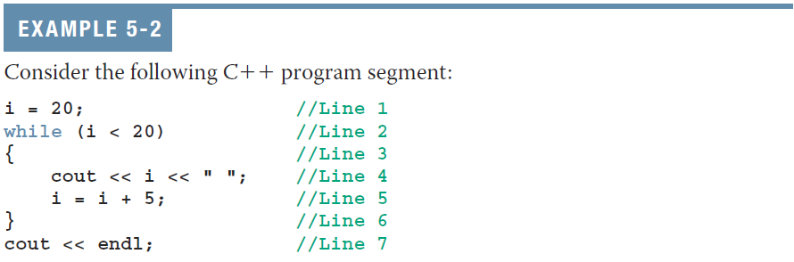
while Looping (Repetition) Structure (cont’d.)

Slide 10
Case 1: Counter-Controlled while Loops
When you know exactly how many times the statements need to be executed
  Use a counter-controlled while loop
counter = 0; //initialize the loop control variable
while (counter < N) //test the loop control variable
{
.
.
.
counter++; //update the loop control variable
.
.
.
}

Slide 11
Case 2: Sentinel-Controlled while Loops
A sentinel variable is tested in the condition
The loop ends when the sentinel is encountered
The following is an example of a sentinel-controlled while loop:
cin >> variable; //initialize the loop control variable
while (variable != sentinel) //test the loop control variable
{
.
.
.
cin >> variable; //update the loop control variable
.
.
.
}

Slide 12
for Looping (Repetition) Structure (1 of 7)
for loop: called a counted or indexed for loop
Syntax of the for statement
The initial statement, loop condition, and update statement are called for loop control statements

Slide 13
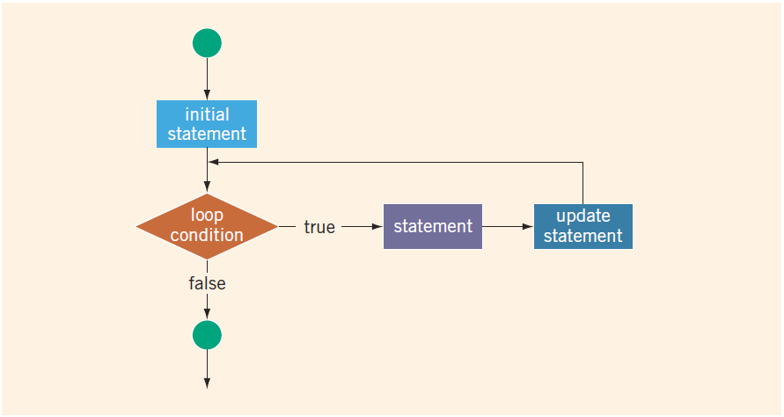
for Looping (Repetition) Structure (2 of 7)
FIGURE 5-2 for loop

Slide 14
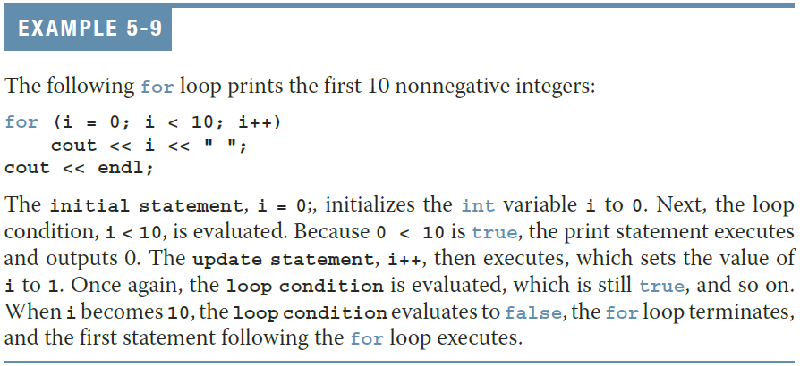
for Looping (Repetition) Structure (3 of 7)

Slide 15
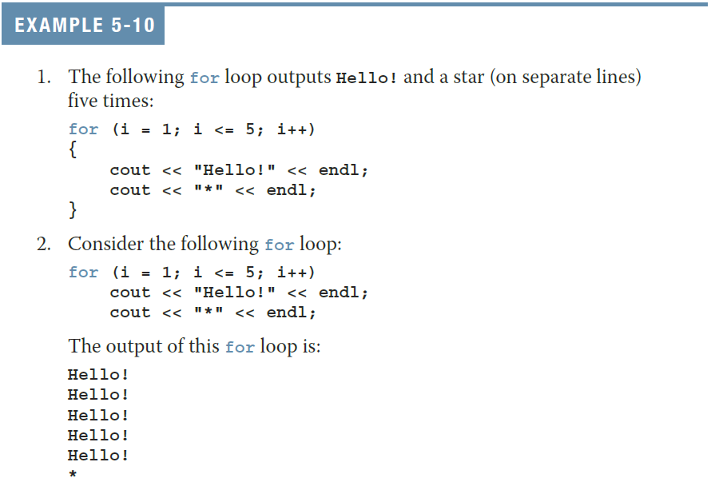
for Looping (Repetition) Structure (4 of 7)

Slide 16
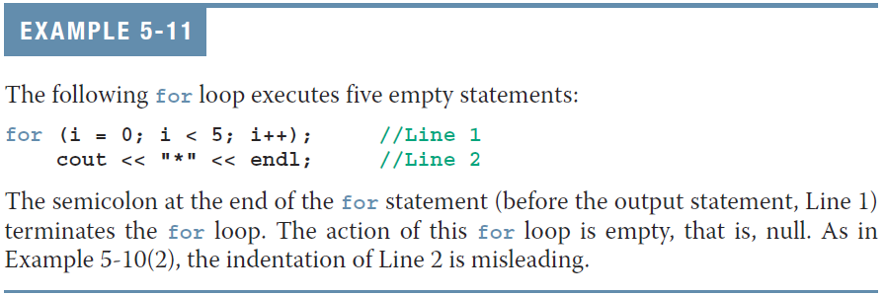
for Looping (Repetition) Structure (5 of 7)
The following is a semantic error:
The following is a legal (but infinite) for loop:
  for (;;)
  cout << "Hello" << endl;

Slide 17
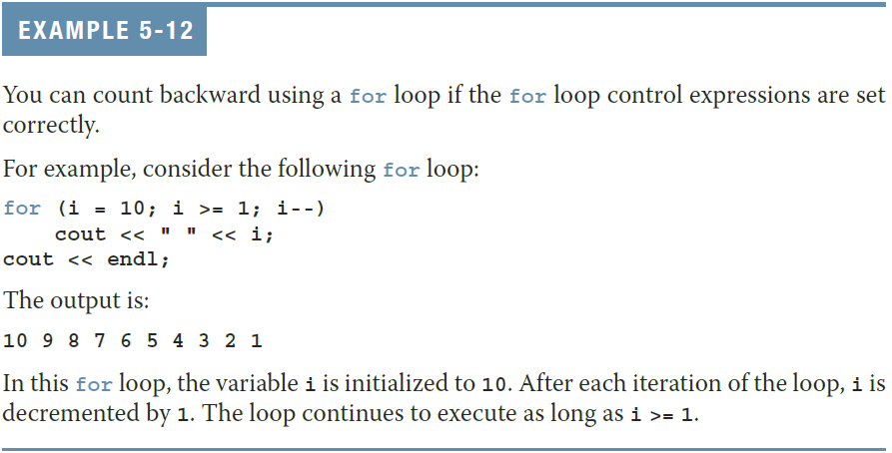
for Looping (Repetition) Structure (6 of 7)

Slide 18
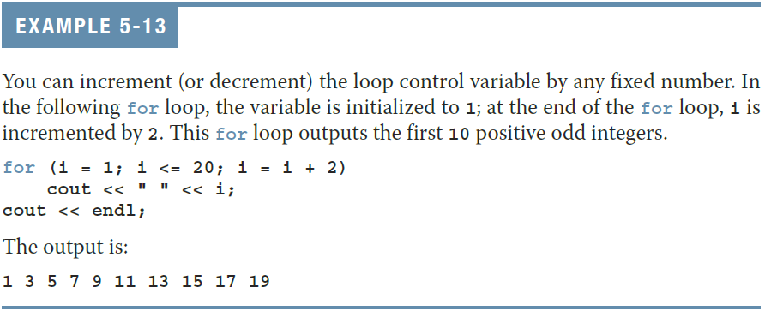
for Looping (Repetition) Structure (7 of 7)

Slide 19
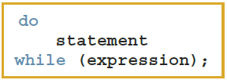
do…while Looping (Repetition) Structure (1 of 6)
Syntax of a do...while loop
The statement executes first, and then the expression is evaluated
  As long as expression is true, loop continues
To avoid an infinite loop, body must contain a statement that makes the expression false

Slide 20
do…while Looping (Repetition) Structure (2 of 6)
The statement can be simple or compound
Loop always iterates at least once

Slide 21
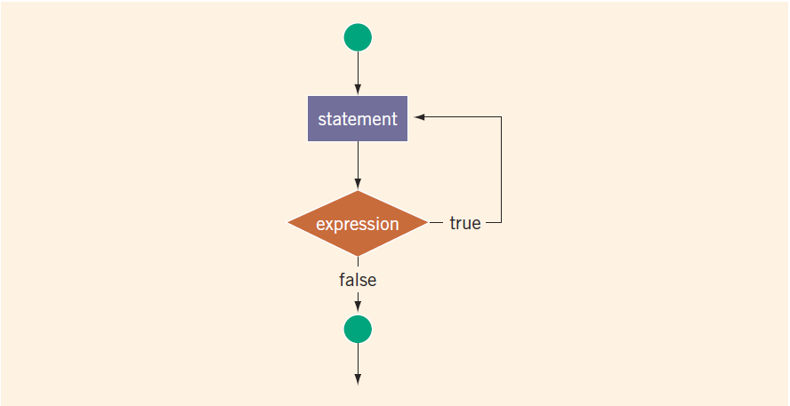
do…while Looping (Repetition) Structure (3 of 6)
FIGURE 5-3 do. . .while loop

Slide 22
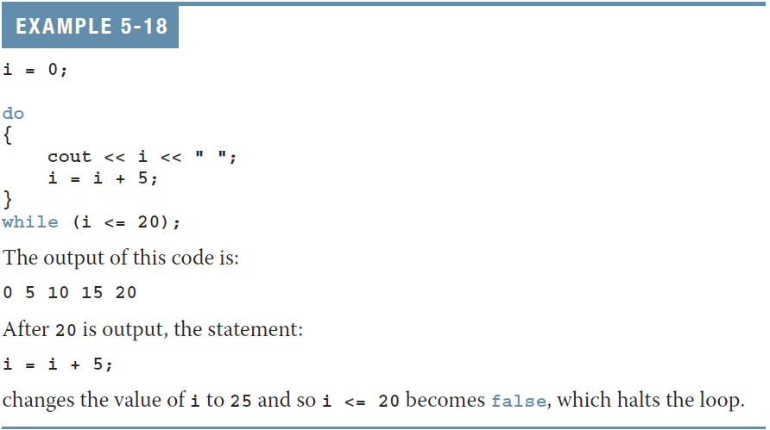
do…while Looping (Repetition) Structure (4 of 6)

Slide 23
do…while Looping (Repetition) Structure (5 of 6)
Note that while and for loops are pretest loops
  It is possible that these loops many never activate due to entry conditions
In contrast, do. . .while loops are posttest loops
  These loops always execute at least once

Slide 24
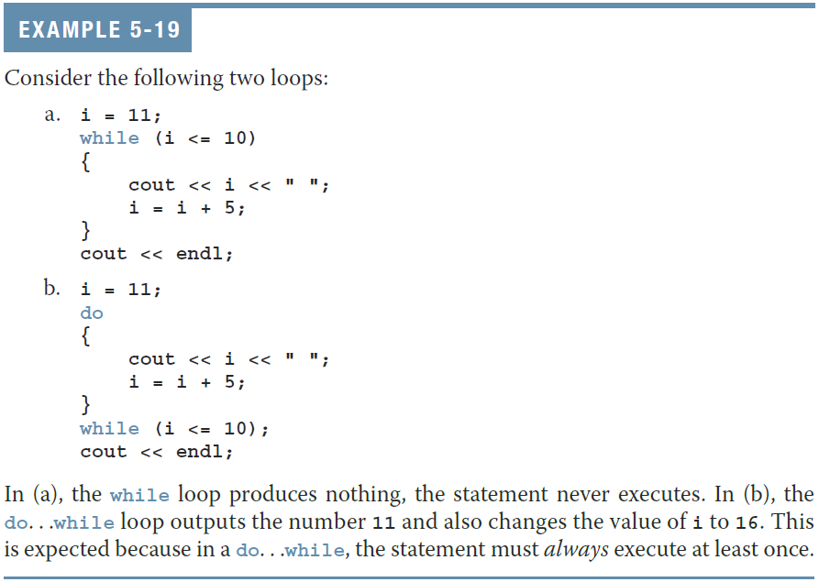
do…while Looping (Repetition) Structure (6 of 6)

Slide 25
Choosing the Right Looping Structure
All three loops have their place in C++
  If you can determine in advance the number of repetitions needed, the for loop is the correct choice
  If you do not know and cannot determine in advance the number of repetitions needed, and it could be zero, use a while loop
  If you do not know and cannot determine in advance the number of repetitions needed, and it is at least one, use a do...while loop

Slide 26
Nested Control Structures (1 of 2)
To create the following pattern:
*
**
***
****
*****
We can use the following code:
  for (i = 1; i <= 5; i++) //Line 1
  { //Line 2
  for (j = 1; j <= i; j++) //Line 3
  cout << "*"; //Line 4
  cout << endl; //Line 5
  } //Line 6

Slide 27
Nested Control Structures (2 of 2)
What is the result if we replace the first for statement with this?
for (i = 5; i >= 1; i--)
Answer:
*****
****
***
**
*

Slide 28
Quick Review (1 of 2)
C++ has three looping (repetition) structures:
  while, for, and do…while
while, for, and do are reserved words
while and for loops are called pretest loops
do...while loop is called a posttest loop
while and for may not execute at all, but do...while always executes at least once

Slide 29
Quick Review (2 of 2)
In a while loop:
  The expression is the decision maker
  The statement is the body of the loop
A while loop can be:
  Counter-controlled
  Sentinel-controlled
  EOF-controlled
In the Windows console environment, the end-of-file marker is entered using Ctrl+z

Slide 30
Exercise 1
Write C++ program following instruction below:
Set total to Zero
Set count to zero
Do
Input the next mark
Add one the count
Input the respond to Y/N
While respond equal to ‘Y’
Set the average to the total divided by count
Display the average, total & count.

Slide 31
Exercise 2
Write a C++ program to display 10 times of I LOVE C++ in different line. The following is sample of output:
I LOVE C++
I LOVE C++
I LOVE C++
I LOVE C++
I LOVE C++
I LOVE C++
I LOVE C++
I LOVE C++
I LOVE C++
I LOVE C++

Slide 32
Exercise 3
A program is written to let users input any number, then calculate the sum of the numbers and also count the number of numbers entered. Display the total and the count of the number. The program will automatically stop when the user input number -999.

